Slide 1
Quality of Information (QoI)
Ramesh Govindan
ramesh@usc.edu
11 May 2011
Notes:
This template should be read in conjunction with the latest draft “roadmap” overview
presentation, which is available on the repository as
https://ns-cta.org/projects/netsci/browser/docs-team/trunk/irc/Roadmap/Roadmap_abridged.pptx

Slide 2
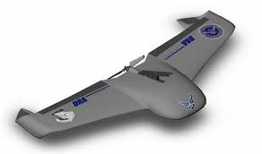




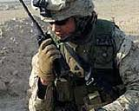
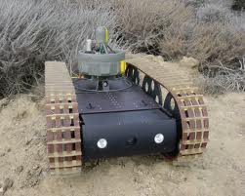

Drowning in Data
Sensors and humans
generate data
Data can
overwhelm
tactical wireless
networks
Data can
overwhelm
analysts
A tactical wireless network

Slide 3




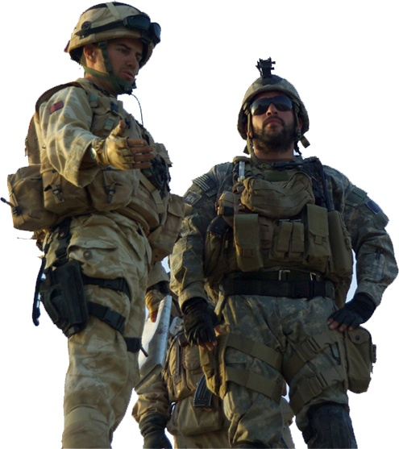





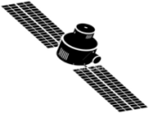
Drowning in Data
Social Networks
HUMINT
J. Eicke, Data to Decision
Experts
Databases
Data can
overwhelm
tactical wireless
networks
Soft Data
Decision Making
Data can
overwhelm
analyst or
decision-maker
Policies
Cultural Understanding
Sensors
National Assets
Networks

Slide 4

How to Avoid Drowning in Data Tasking, Communications, Processing, Exploitation, Dissemination
Put data & information into context aimed at specific decision(s)
J. Eicke, Data to Decision
Make data useable, discoverable, malleable
Move relevant conclusions to decision makers
UNCLASSIFIED
CLASSIFIED
SHARED
NOT SHARED
Decision Makers
Moving queries, data & information in a timely way
Seeking information based on decisions made or to be made

Slide 5

QoI: A Multi-Genre Approach
Exploitation
….
Processing
Information Network
Communication
Tasking
Communication Network

Slide 6
QoI: An Information-Centric Approach
Operation Commander
Commands
Analyst
Fusion of information with quantifiable uncertainty
Addresses
analyst cognitive load
Desired Quality
of Information
May have insufficient
information to fulfill request
Information Network
Information of requisite or higher quality
Desired Quality
of Information
Addresses
tactical wireless
network bottleneck
Communication Network

Slide 7
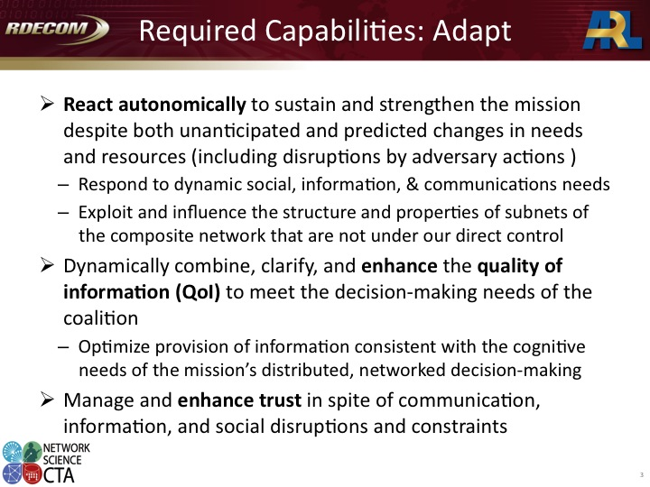
QoI in the context of the NS CTA Roadmap
Extract timely, relevant information of the requisite quality to facilitate reliable decision making

Slide 8

Quality of Information (QoI)
Data
Information
Precision, Freshness,
Provenance, Security
Intrinsic Attributes
QoI
Accuracy, Credibility,
Timeliness, Content-tags
Contextual Attributes

Slide 9


Quality Transformations
Information can
be processed
Transcript of audio
Extracted clip of relevant information
Information can
be fused

Slide 10

A Motivating Scenario
Narrative influenced by
discussion with Paul Sullivan
(ARL Consultant)
Operation Commander
Was there any activity
around facility X at noon?
Yes, 4 people entered from the East side, etc.
Analyst
Person or Vehicle
Location=Facility X
Time=11:55am-12:05pm
Within=1 minute
Has video from North, South and East around noon
Location=West side of X
Time=11:55am-12:05pm
Type=Image
Tag=person OR Vehicle
Within=35 seconds
Information Network
Location=West side of X
Time=11:55am-12:05pm
Type=VGA Video
Within=45 seconds
Real-time surveillance indicates a
developing situation at facility X.
A commander wishes to quickly obtain
information about prior activity at X
before deciding how to respond.
Communication Network

Slide 11
A Motivating Scenario
Operation Commander
Who entered X from the
West at 12:01?
Analyst
Identity of Person
Confidence=High
Location=West side of X
Time=12:01pm
Within=30 seconds
Information Network
Location=West side of X
Time=12:01-12:02pm
Type=HD 1080p
Within=25 seconds
Communication Network

Slide 12
Capabilities and Leverage Points
Operation Commander
Was there any activity
around facility X at noon?
Yes, 4 people entered from the East side, etc.
Analyst
Person or Vehicle
Location=Facility X
Time=11:55am-12:05pm
Within=1 minute
Has video from North, South and East around noon
Location=West side of X
Time=11:55am-12:05pm
Type=Image
Tag=person OR Vehicle
Within=35 seconds
Information Network
Location=West side of X
Time=11:55am-12:05pm
Type=VGA Video
Within=45 seconds
Inference and fusion
to reduce uncertainty
and analyst load
Delivery of requisite information to conserve wireless network
resources
Leverage other programs
(e.g., DARPA VIRAT)
Communication Network

Slide 13
Constraints and Challenges
Volume of Data
High-definition video provides
significant context for decision-making
A QoI Theory of Fusion
Characterizing and Optimizing QoI
in a Communications Network
Information comes from different sources,
has different modalities, may support or contradict
other information, can have intrinsic error, may
be unstructured
Diversity of Information
Dynamics
Situations develop quickly, information changes
rapidly, and decisions must be made swiftly
Understanding
Cross-Genre Interactions

Slide 14
Research Thrusts
A Quality-of-Information Theory for Sensor Data Collection and Fusion
Develop a unified theory for QoI-aware information inference and fusion that accommodates soft and hard information sources, supports heterogeneous content times, incorporates prior information, and accounts for social factors
Characterizing and Optimizing Quality-of-Information
Develop the theory and practice of extracting timely, relevant information of the requisite quality from tactical wireless networks in order to facilitate reliable decision making

Slide 15


QoI Fusion Theory: An Example
Abdelzaher, Cao, Govindan, LaPorta, Yener
Analyst
Desired Quality
Of Information
Inference Algorithms Operate
On Linked Structures
Information Network contains
Linked Information Structures
Information Network
Desired Quality
of Information
Information
Structure (e.g., track)
Communication
Network

Slide 16

The Puzzle Model of Information Structures
Each information structure can be thought of as a puzzle
At any given instant, one or more pieces of the puzzle may be missing
May not know that pieces are missing!
QoI-Aware inference algorithms may infer missing pieces from existing information
When necessary, they may request information of sufficient quality from the tactical wireless network
Identity of Person
Confidence=High
Location=West side of X
Time=12:01pm
Within=30 seconds
Person or Vehicle
Location=Facility X
Time=11:55am-12:05pm
Within=1 minute
Has video from North, South and East around noon
Information Network
Information Network
Location=West side of X
Time=12:01-12:02pm
Type=HD 1080p
Within=25 seconds
Communication Network
Abdelzaher, Cao, Govindan, Laporta, Roth, Yener

Slide 17
A Concrete Instance
PictureNet: A service for sharing pictures (e.g., to quickly survey damage in the aftermath of disasters)
Nodes = pictures, Link weight = semantic similarity
Goal: Maximize accuracy (completeness) of areas in distress, subject to network constraints
Request these pictures

Slide 18
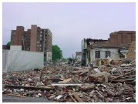
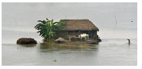
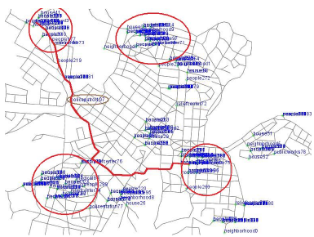
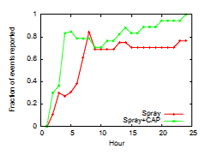
Evaluation of PictureNet
Improves fraction of identified distress areas by up to 20%
20% better survivor recovery potential

Slide 19
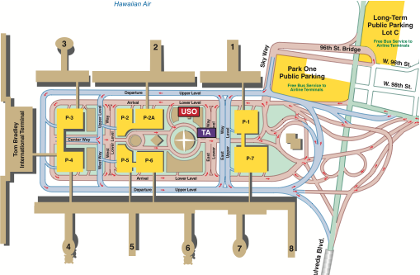
Another Inference Problem
Suspect’s Track
Information
Structure
Missing Puzzle Pieces
Decision: Are the suspects working together?
Most Important
Piece to be filled

Slide 20
Another Inference Problem
Suspect’s Track
Main Challenges:
Map decision to query on information structure
Infer missing pieces from existing data/prior knowledge with sufficient quality for intended use
Negotiate with wireless network to get highest quality of information
Information
Structure
Missing Puzzle Pieces
Decision: Are the suspects working together?
Most Important
Piece to be filled

Slide 21
Optimizing QoI in Wireless Networks
What are the benefits of QoI-enabled wireless networks?
Hasn’t existing networking research addressed this?
Experiment
Scenario
Need real-time video of a neighborhood
Need to know activity at mid-day near a tower

Slide 22
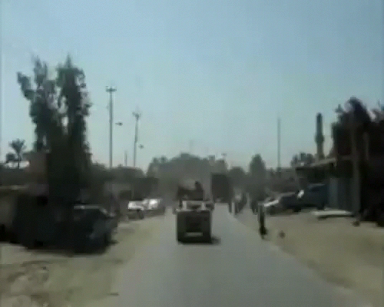

A Best-Effort Network
In a best-effort network, the network
attempts to deliver traffic as best it can
Video quality not sufficient for
decision-making
Tower Video
Real-time Feed

Slide 23
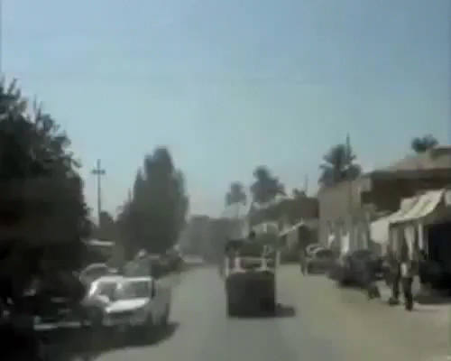
QoS-Enabled Network
In a QoS-enabled network, the network
provides service guarantees by explicitly
reserving network resources and may
perform admission control
Real-time Feed
The two videos can only be delivered
sequentially: not enough network
capacity to achieve concurrent transmission
Can violate timeliness requirements

Slide 24
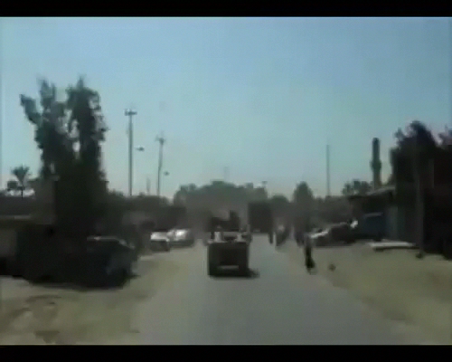
A QoI-Enabled Network
In a QoI-enabled network, the source can extract image frames
showing activity near tower at midday, and transmit them
concurrently with video feed
Tower Images
Real-time Feed

Slide 25
A QoI-Enabled Network
In a QoI-enabled network, the source can extract image frames
showing activity near tower at midday, and transmit them
concurrently with video feed
Tower Images
Real-time Feed
How does analyst know
what transformation is sufficient?
How does the network determine
that the two requests for information
can be simultaneously satisfied?
QoI Functions
Operational
Information-Content
Capacity

Slide 26
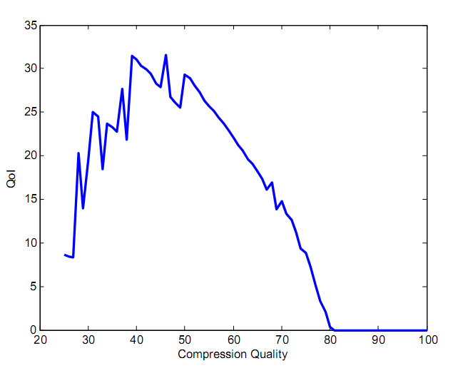
QoI Functions
LaPorta, Cook, Cirincione, Sullivan, Govindan
Identity of Person
Confidence=High
Location=West side of X
Time=12:01pm
Within=30 seconds
Need accurate scanned image
within 1 second
Task
Information Network
At lower compression,
timeliness may be violated
At higher compression,
loss of recognition accuracy
Location=West side of X
Time=12:01-12:02pm
Type=HD 1080p
Within=25 seconds
Acceptable QoI
Communication Network

Slide 27
QoI Functions
Encouraging result
For some images, there exist tradeoffs in application accuracy vs. information quality, which can be exploited by our framework
Future work
Generalizing this to other tasks
Extending to multiple dimensions
Incorporating other media, such as audio or video
Leverage earlier work on perception metrics

Slide 28
QoI and Network Information Capacity
Linkage: C.1.1
LaPorta, Psounis, Ramanathan, Yener, Govindan
Information Network
Desired quality
of Information
Models of network
characteristics, mobility,
dynamics
What is the Operational
Information-Content
Capacity of the network?
Which requests can be satisfied?

Slide 29
OICC Research Contributions
Developed a framework for computing the OICC of a general network
Derived OICC for several canonical networks
Derived symptotic performance bounds for realistic finite networks
Ideas and approaches applied to analysis of JTRS WNW network

Slide 30
Other Research Threads
Exploiting Links in Information Networks to Improve QoI of Data Fusion
QoI-Aware Sensor Selection (Amotz’s talk)
Optimizing Credibility and Provenance in Tactical Wireless Networks
Aqua: A QoI Software Architecture
ARL Involvement from early stages (Cook, Marcus and Scott)
Questions?

